Slide 1
Capstone Project-1
Customer Churn Prediction
Team Members:
Uday Singh- 2210992473
Vaibhav Sheoran-210992490
Vaibhav Tiwari- 2210992491
Vedansh Katyal - 2210992519

Slide 2
CONTENT
Problem Statement
Objective
□ Tools Used
Data Summary
Challenges
Recommendations
Conclusions
□ Q & A

Slide 3
PROBLEM STATEMENT
Develop an AI-ML solution for customer churn prediction to address the pressing challenge of retaining valuable customers. The project involves integrating diverse data sources, selecting relevant features, training and evaluating predictive models, ensuring real-time predictions, enhancing interpretability, and scalability. The goal is to empower businesses with actionable insights to reduce customer churn, maximize revenue, and improve long-term customer satisfaction.

Slide 4


Slide 5
OBJECTIVE
The objective of customer churn prediction in an AI-ML project is to identify customers at risk of leaving and take proactive measures to retain them. This helps businesses minimize customer loss, optimize revenue, enhance customer satisfaction, and gain a competitive edge through data-driven decision-making.
The key goals of implementing customer churn prediction in an AI-ML project include:
Early Identification: Predicting customer churn enables businesses to identify potential churners early in their customer lifecycle. By doing so, companies can take proactive measures to retain those customers before they decide to leave.
Cost Reduction: Acquiring new customers is generally more expensive than retaining existing ones. By predicting and preventing churn, companies can reduce the costs associated with customer acquisition and maintain a more stable customer base
.
Customer Satisfaction: Understanding the factors that contribute to customer churn helps companies improve their products, services, and overall customer experience. This can lead to increased customer satisfaction and loyalty.

Slide 6
Tools Used
Google Collab is used as IDE .
Pandas and NumPy are used for Data Manipulation & Pre-processing and Mathematical functions respectively.
Exploratory data analysis is automated by data prep.
For visualization of the plots, Matplotlib, Seaborn, Plotty are used.
GitHub is used as version control system.

Slide 7



DATA SUMMARY
Customer Support Interactions:
1) Number and type of customer support tickets raised.
2) Resolution times and customer satisfaction with support.
Customer Interaction Data:
Frequency of interactions with the product or service.
Usage patterns, such as login frequency or duration of usage.
Social Media Activity:
Customer engagement on social platforms.
Sentiment analysis of social media mentions related to the product or service.

Slide 8
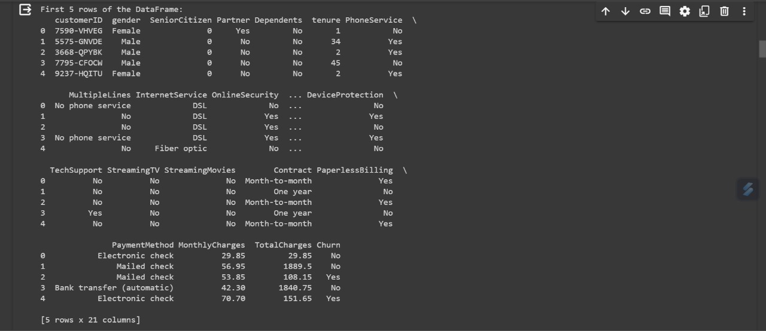
DATA SUMMARY
This is the Customer Churn Pridiction. In the below table it shows the top and bottom 5 rows and 5 Column respectively

Slide 9
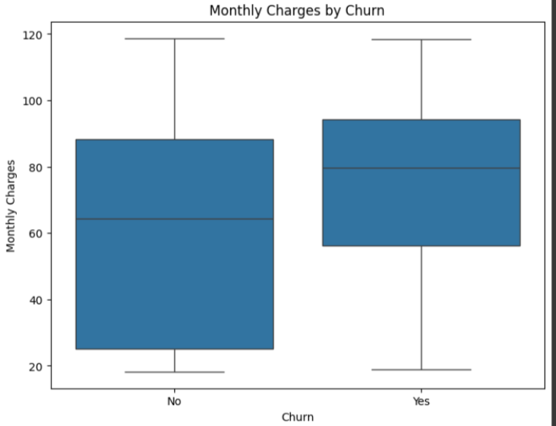
Monthly Charges by Churn
Boxplots compare tenure distributions for churned vs. non-churned customers
Boxplots compare tenure distributions for churned vs. non-churned customers.
Boxplots compare tenure distributions for churned vs. non-churned customers

Slide 10
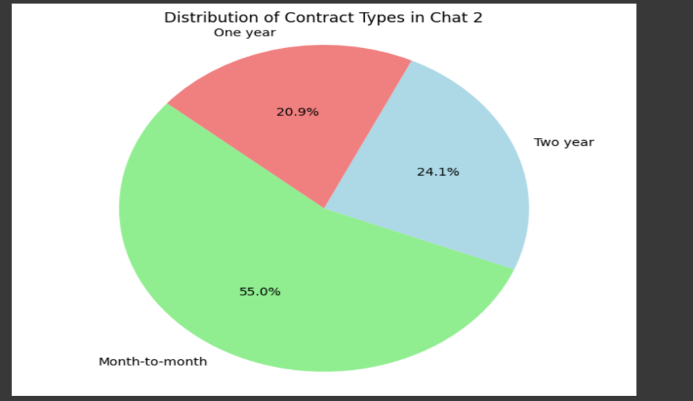
Distribution of Contract types
The pie chart was chosen to visualize the distribution of contract types in Chart 2 because it effectively represents the proportional distribution of categorical data (Contract types). It is suitable for a clear and quick comparison of the different contract types and is visually simple for easy interpretation.

Slide 11
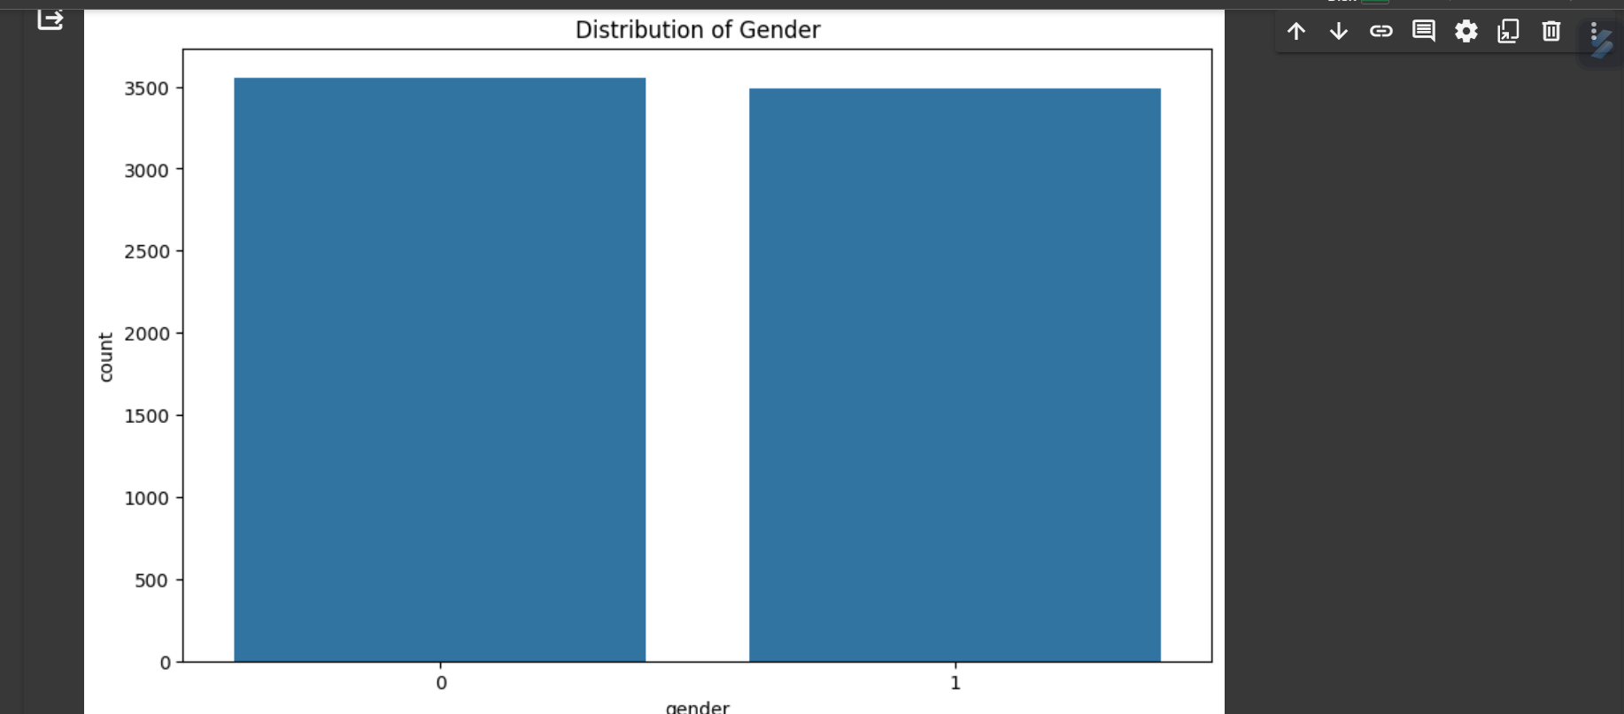
Distribution of Gender
The bar chart was chosen because it effectively visualizes the count or frequency of categorical data, making it suitable for displaying the distribution of gender in the dataset. It allows for easy comparisons between different gender categories and is clear and straightforward in its representation.

Slide 12
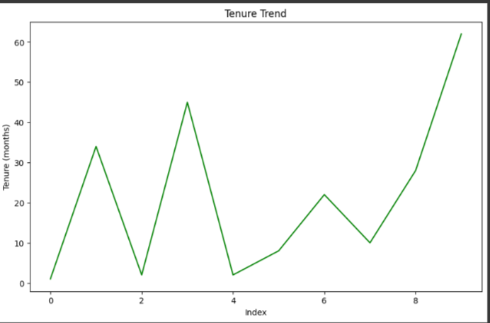
Trend of Tenure
The chosen chart is a Stacked Area Chart, represented by a lineplot with the "tenure" on the x-axis and "Churn" on the y-axis. Stacked Area Charts are effective for illustrating the cumulative contribution of multiple variables (Churn) over time (Tenure). This visualization is suitable for showing trends and patterns in Churn rates throughout the tenure

Slide 13
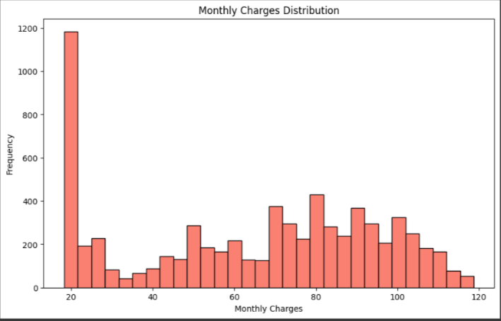
Monthly Charge Distribution
The chosen chart is a Bubble Chart, representing Monthly Charges vs Total Charges, with bubble size indicating tenure. A Bubble Chart is effective for visualizing the relationships between three numerical variables simultaneously, providing insights into the correlation between Monthly Charges, Total Charges, and the impact of tenure on the size of each data point.

Slide 14
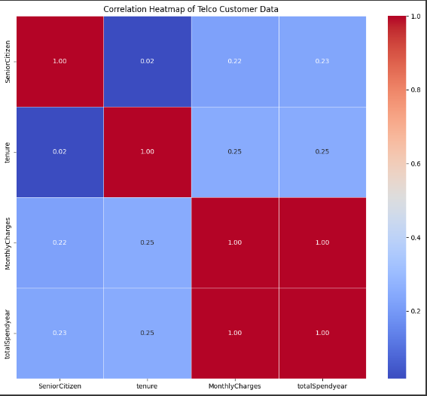
Correlation Matrix
The chosen chart is a Correlation Heatmap, illustrating the correlation matrix of the dataset. This heatmap effectively displays the strength and direction of relationships between different variables, aiding in identifying patterns, dependencies, and potential multicollinearity in the data.

Slide 15
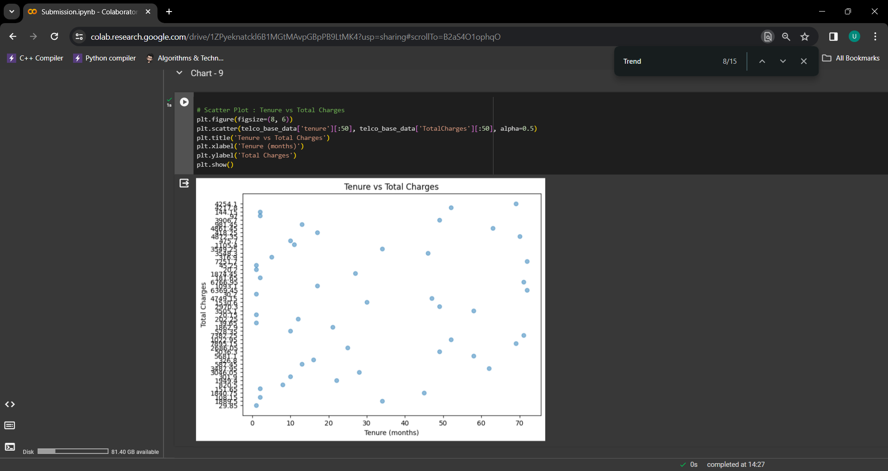
Tenure Vs Total charges
The chart displays the relationship between monthly charges and total charges. Scatter plots visualize the relationship between two continuous variables.

Slide 16
Challenges
Data availability and quality:
Access to sufficient historical data with accurate customer information is crucial.
Data may be incomplete, contain errors, or be inconsistent across sources, impacting model accuracy.
Modeling challenges:
Model selection and optimization:
No single model is universally optimal for all scenarios. Different models may perform differently depending on the data and business objectives.
Tuning hyperparameters to optimize model performance requires expertise and experimentation.

Slide 17
Recommendations
Identify Relevant Data: Collect comprehensive customer data covering demographics, usage patterns, interactions, and customer support inquiries.
Data Cleaning and Preprocessing: Ensure data quality by addressing missing values, inconsistencies, and outliers.
Feature Engineering: Create insightful features from raw data, like customer lifetime value, recency of purchase, and engagement metrics.
Model Selection and Training: Choose appropriate machine learning models like logistic regression, random forests, or gradient boosting trees. Train the model on historical data with churn labels.
Model Evaluation and Tuning: Evaluate model performance using metrics like accuracy, precision, and recall. Fine-tune hyperparameters and compare different models to achieve optimal results.

Slide 18
Conclusions
Customer churn prediction, using machine learning models, analyzes past customer behavior to identify patterns that might indicate a high likelihood of a customer leaving. This helps businesses proactively engage these at-risk customers with targeted campaigns or incentives, potentially reducing churn and increasing customer lifetime value. In essence, it's about predicting customer defection to take preventive measures and retain valuable customers.

Slide 19
Q & A

